Slide 1
Protozoal infections of the gastrointestinal tract
Prof. Nilmini Chandrasena

Slide 2
Common clinical presentations of protozoal infections of GI tract
Diarrhoea
Loss of weight / failure to thrive
Extra-intestinal presentations

Slide 3
Transmission is Faeco-oral
Common in areas deficient in
Sanitation
Purified water
Hygiene

Slide 4
Diarrhoea
Classified (stool type)
Dysentery (inflammation of the wall of the colon)
Watery diarrhoea
Steatorrhoea
Classified (duration)
Acute
Chronic

Slide 5
Aetiology
Dysentery – amoebiasis & shigellosis others ( entero-haemorrhagic & entero-invasive E.coli, salmonella species, C. jejuni, Y. enterocolitica & trichuriasis)
Watery diarrhoea - cryptosporidiosis,
viral & bacterial gastroenteritis, cholera
Steatorrhoea – Giardiasis

Slide 6
Loss of weight
Aetiology
Infective & non-infective
Chronic diarrhea causing parasitic agents
G. intestinalis
Cryptosporidium species
S. stercoralis

Slide 7
Amoebiasis
Entamoeba histolytica
Amoebic colitis (amoebic dysentery)
Amoebic liver abscess
Others
Pleuro-pulmonary amoebiasis
Cerebral amoebiasis
Rare
Cardiac, genitourinary & cutaneous

Slide 8
Amoebic colitis - invasion of wall of colon by
E.histolytica trophozoites
Common presentations
Blood & mucus diarrhoea (gradual onset)
Abdominal pain, and tenderness (several weeks)
Other manifestations
Rectal bleeding (children)
Fever ~ 10-30%
Weight loss & anorexia

Slide 9
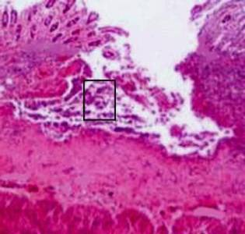
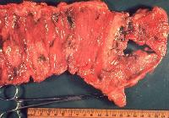
Pathology
Invasion of the of colon –
initial superficial ulcers progress to ulcers with undermined edges ( flask- shaped )

Slide 10
Complications
Fulminant necrotising colitis (0.5%)
Haemorrhage
Intestinal perforation
Amoeboma
Fulminant colitis
Severe bloody diarrhoea
Widespread abdominal pain
Peritonitis
Fever

Slide 11
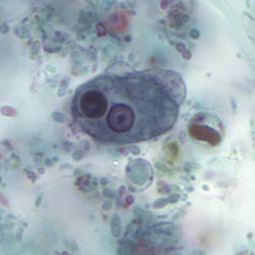
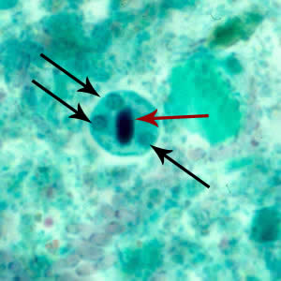
Diagnosis amoebic colitis
Suggestive history & stool appearance
Identification of E. histolytica trophozoites & cysts in rectal / stool smears
Rectosigmoidoscopy
E. histolytica Trophozoite
E.histolytica cyst

Slide 12
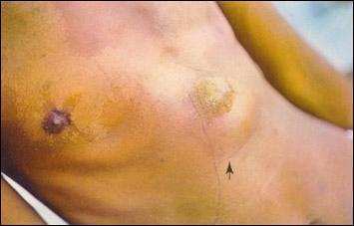
Amoebic liver abscess symptoms & signs
High fever (85-90% )
Right upper quadrant pain & tenderness
(< 10 days)
Cough
Painful hepatomegaly
Mild Jaundice
60- 70% do not have concomitant colitis, but may have a
history of dysentery in the past year (20%)
Commoner in adult males (A history of alcohol abuse)

Slide 13
Pathology
Single abscess in the R. lobe is common
Thin capsular wall, necrotic centre containing thick brown pus, intermediate zone of coarse stroma & outer zone of normal tissue
Properly treated Invasive amoebiasis heal without scarring

Slide 14
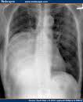
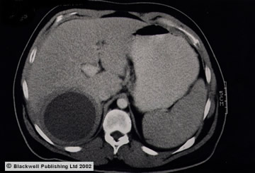
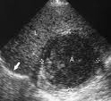
Diagnosis- amoebic liver abscess
Lab investigations
Leucocytosis >10 000/mm3
Liver function tests
Amoebic serology
Stool microscopy
Radiology
Chest x-ray- elevated R. hemidiaphram
Abdominal ultrasonography /
MRI / CT Scans
Amoebic abscess CT scan & Ultrasound

Slide 15
Treatment :invasive amoebiasis
Tissue amoebicides- metronidazole
30mg/kg daily for 8-10 days
Luminal amoebicides- Diloxanide &
Paramomycin
Indications for aspiration of liver abscess
As adjunct to medical therapy (no response after 72 hrs)
If rupture is believed imminent (large)
Left lobe abscess

Slide 16
Other extraintestinal amoebiasis
Peritoneal abscess -rupture of liver abscess / perforation of caecum
Pericardial amoebiasis –complication of liver abscess esp L lobe (1%)
Pleuropulmonary amoebiasis- mostly due to extension of liver abscess
Cerebral amoebiasis
Genitourinary amoebiasis
Cutaneous amoebiasis

Slide 17
Giardiasis
Presentations
Persistent diarrhoea associated with nausea, vomiting, flatulence & abdominal pain
Retardation of growth / loss of weight
Diarrhoea characteristics
Watery diarrhoea progressing to steatorrhoea

Slide 18
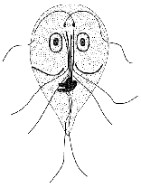
Pathogenesis
Mucosal factors
Distortion of the villous architecture of small intestines
Brush border enzymes
(disaccharidases & lipase)
Carbohydrate & lipid digestion
impaired
Mechanical damage by attached trophozoites
Secreted cytopathic subs

Slide 19
Pathogenesis ..
Giardia trophozoites
Inhibits pancreatic lipase and trypsin
Consumes bile salts
Solubilization of dietary fats
Inhibits pancreatic lipase still further
Steatorrhoea with malabsorption of fat soluble vitamines

Slide 20
Pathology
Mucosal factors
Direct damage by trophozoites
Villi & microvilli
Disaccharidases
Transport protiens
Parasite products
Proteases
Lectin
Immune mediated
Tcell activation
Luminal factors
Bacterial overgrowth
Inhibition of digestive
enzymes
Bile salt deconjugation
Bile salt uptake by trophozoites

Slide 21
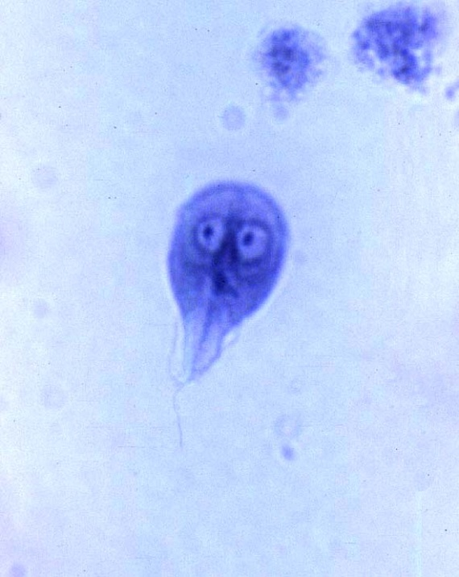
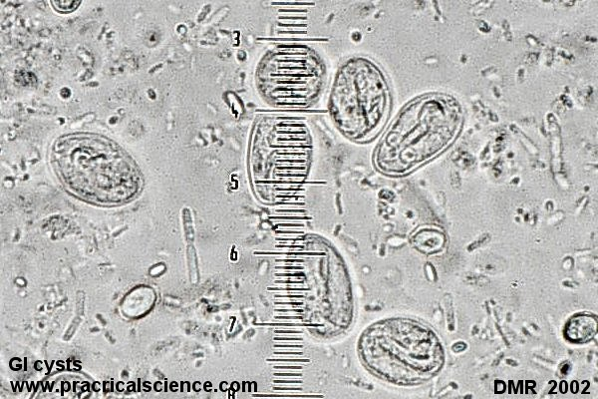
Diagnosis
Hx of persistent diarrhoea / steatorrhoea
Stool microscopy
Microscopy of duodenal aspirate
Endoscopic brush cytology
String test (entero-test)
Faecal antigen ELISA

Slide 22
Treatment & Prevention
Metronidazole 2g daily (single dose) x 3 days
Furazolidine 100 mg 3 times daily for 7-10 days
Prevention
Personal & food hygiene
Use of purified water for drinking & cooking
Improvement of sanitation
Screening & treatment of food handlers

Slide 23
Cryptosporidiosis
Presentations
Profuse watery diarrhoea may be acute (<2 weeks) or chronic (>4 weeks)
Self-limiting in immuno-competent
Life-threatening diarrhoea among the HIV infected/ immuno-compromised
Cause of water-borne & nursery diarrhoea outbreaks
Occupational hazard for livestock farmers , vet. surgeons & students ( a zoonosis)

Slide 24

Pathogenesis
Destruction of microvilli by trophozoites
Reduction of disaccharidase activity
Villous atrophy
Repopulation of villi with immature enterocytes “enterocyte immaturity hypothesis”

Slide 25
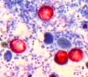
Diagnosis
Based mainly on identification of oocysts in air dried faecal smears stained with
Modified Ziehl-Neelson
Auramine
Immunofluorescence
ELISA- detect cryptosporidial antigens
PCR

Slide 26
Management
No effective treatment to eradicate infection in all cases
Nitazoxanide is effective in HIV un-infected
children (100 mg bd x 3 days)
Fluid & electrolyte replacement

Slide 27
Prevention
Use of purified water for drinking
Good personal hygiene
Immunodeficient individuals to avoid swimming in public water
C. parvum Oocysts can be killed by
Boiling
Freezing
Drying
3% hydrogen peroxide

Slide 28
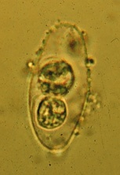
Other intestinal Coccidia
Isospora belli - opportunistic
Cyclospora cayetanensis
Treatment- Cotrimoxazole
Oocyst of I. belli

Slide 29
Rare opportunistic agents
The Microsporidia (Intracellular location in
small intestinal enterocytes)
Enterocytozoon bieneusi
Encephalitozoon intestinalis
Diagnosis - Electron microscopy of biopsy
Specimens
Treatment- Albendazole

Slide 30
Diagnosis
To exclude infections at least 3 stool samples passed within a period of 10 days to be examined by
Direct & stained stool smears (iron haematoxylin/ trichrome/ modified Ziehl Neelson etc)
Stool concentration techniques

Slide 31
Management
Prevention & control
Personal hygiene
Provision of purified drinking water
Sanitary disposal of excreta
Screening & treatment of food handlers
& contacts
Treatment of cases
Health education
Treatment
Metronidazole

